Slide 1
NODE.JS
(The Backend Of MERN Stack)
Lecture 43

Slide 2
Today’s Agenda
Session Tracking
Need Of Session Tracking
How Session Works ?
Using Session In Express
Examples

Slide 3
Session tracking
A website is based on the HTTP protocol and HTTP is a stateless protocol .
What is stateless ?
Stateless means that as soon as the response is generated by the server , the connection gets terminated and the server forgets everything regarding the current request it has served .

Slide 4
Session tracking
Thus if the same user makes another request then the server will not consider it to be the second request by the client in continuation rather the server will again assume the same client to be a new user.

Slide 5
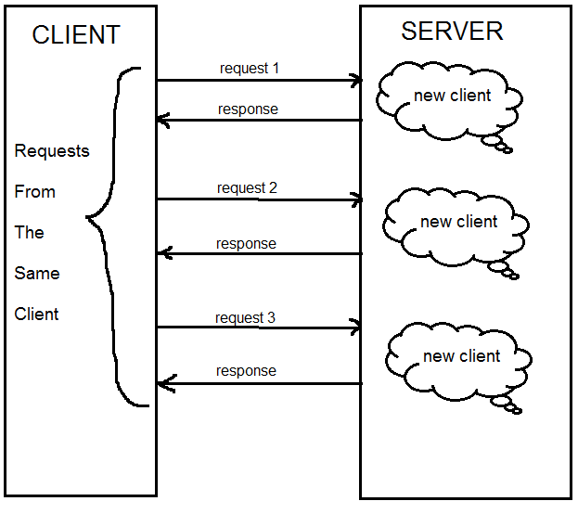
Session tracking

Slide 6
Why stateless is a problem ?
In most of the cases this stateless nature of http will not be a problem.
But there are certain scenarios which require that the server should be able to identify the client and associate him with previous request.

Slide 7
Example-1
In a shopping cart application a client keeps on adding items into his cart using multiple requests.
Now , whenever a request is made by the client to add a new item, the server must add the new item in the same client’s existing cart.
So in this scenario, there is a certain need for session tracking.

Slide 8
Example-2
If a user has logged into his Bank Account and after successful login if he wishes to go to the Funds Transfer page then he would be required to login again.
This is because the Funds Transfer would be a login-protected page and the Web Server doesn't have any built-in support for recognizing if the client requesting this page is the one who is already logged in or if it's coming from a new client.

Slide 9
What is session tracking ?
The term session means the time period the user has spent while navigating a website and if the site keeps track of all his activities then it is called session tracking.
Thus in short we can say that session tracking means creating a log of user activities.

Slide 10
How session works ?
When the client makes a login request to the server, the server will create a session with a unique id and store it on the server-side.
The server then responds to the client and sends a cookie containing the session’s unique id stored on the server, which will now also be stored on the client.

Slide 11
How session works ?
This cookie will be sent on every request to the server.
The server uses this session ID and looks up the session saved in the session store to maintain a one-to-one match between a session and the cookie.
This will make it possible for the server to recognize the client and his previous data.

Slide 12
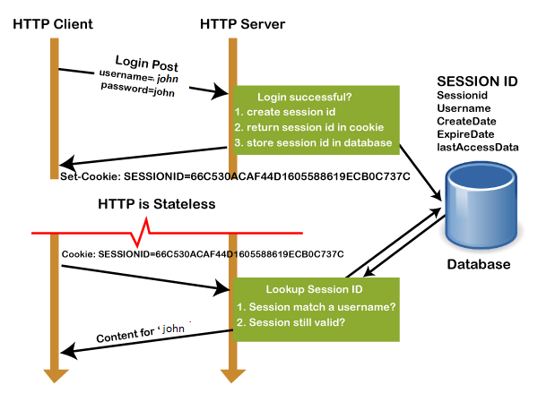
How session works ?

Slide 13
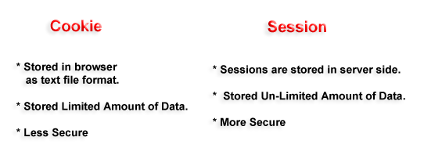
cookie v/s session

Slide 14
How to use session in express ?
To use session in node/express we need to install the npm package called express-session.
npm install express-session
Next, we need to import it in our application and use it as middleware before our routes as shown in next slide

Slide 15
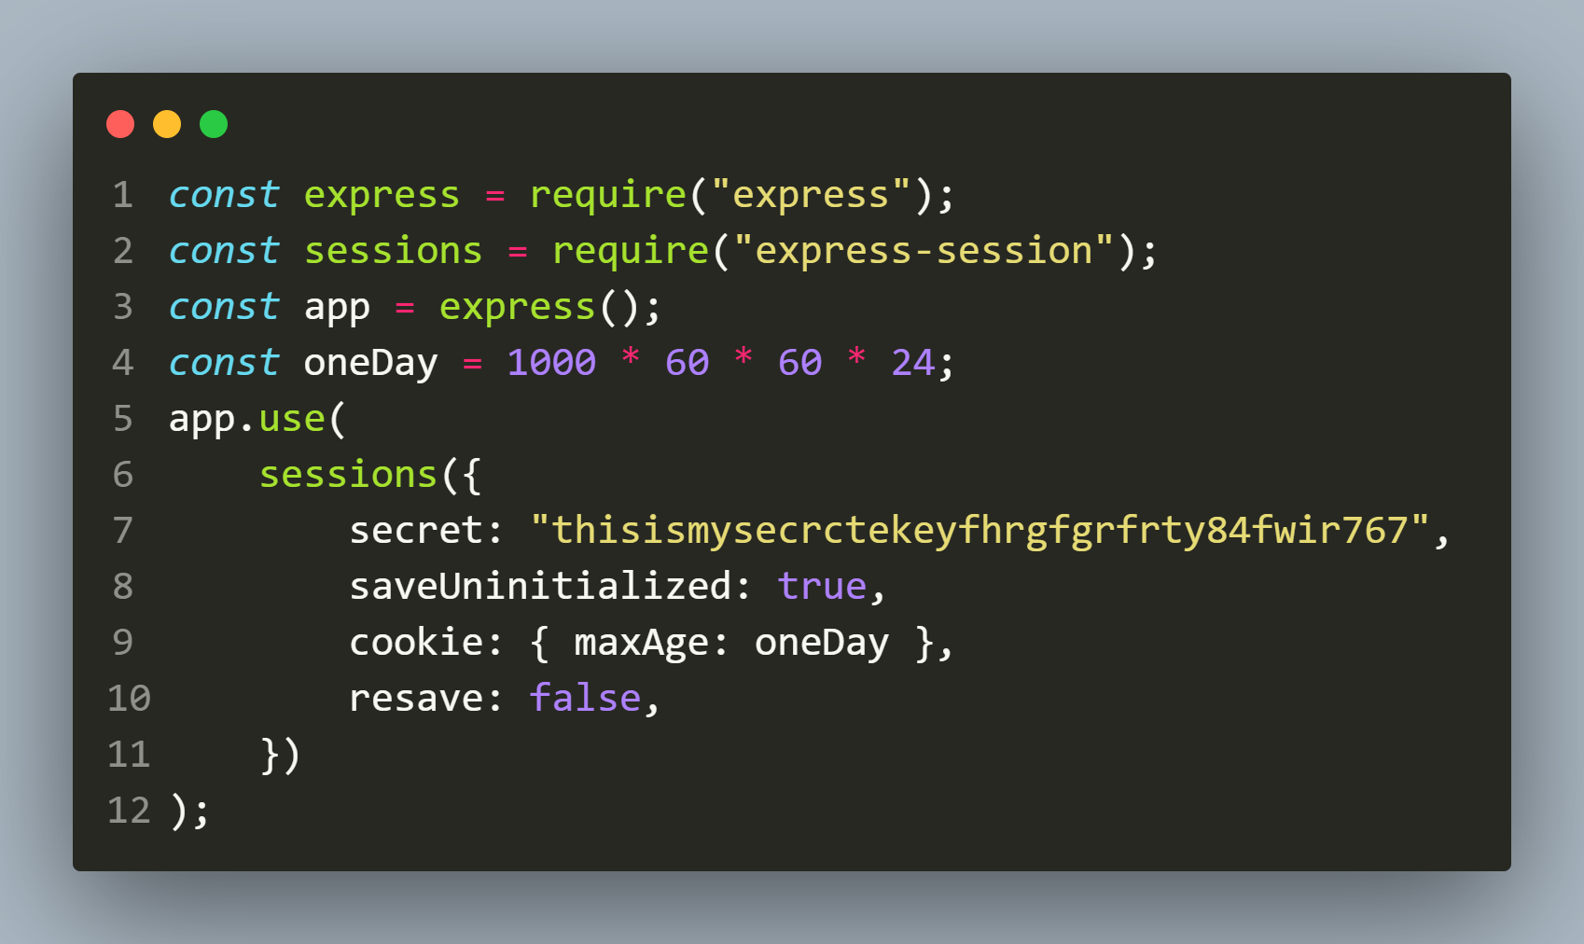
Using session in express js

Slide 16
Explanation of keys
secret: The secret is used to compute a hash against the session ID. This helps to prevent session hijacking.
resave: It forces the session to be saved back to the session store, even if the session was never modified during the request.

Slide 17
Explanation of keys
saveUninitialized: This allows any uninitialized session to be sent to the store. When a session is created but not modified, it is referred to as uninitialized.
cookie: { maxAge:oneday}: This sets the cookie expiry time. The browser will delete the cookie after the set duration elapses and the cookie will not be attached to any of the requests in the future.

Slide 18
Storing data in session
To store our data in a session we use the request.session object and set the key-value pair in it.
Syntax:
req.session.<key>=<value>;
Example:
req.session.username=‘Sachin’;

Slide 19
Getting session data
We can access the session data using the session property of request object.
Syntax:
<var_name>=req.session.<key>;
Example:
let name=req.session.username;

Slide 20
Exercise 89
Create an Express application for handling 2 routes:
GET / : This route should create and store the current date and time when the user visited the site. It should also provide a link to the user to visit the next route.
GET /show : This route should read and display the user’s last visited date and time through the session.

Slide 21
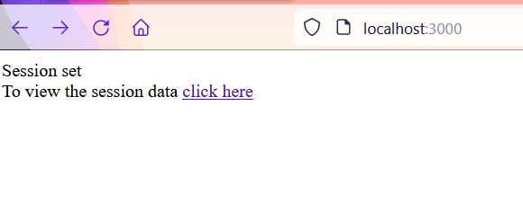
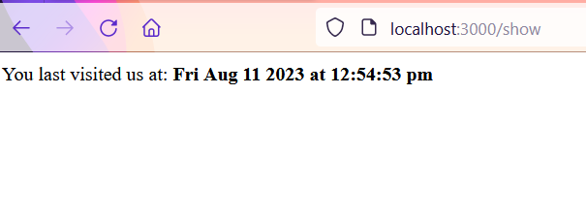
Desired output
http://localhost:3000
http://localhost:3000/show

Slide 22
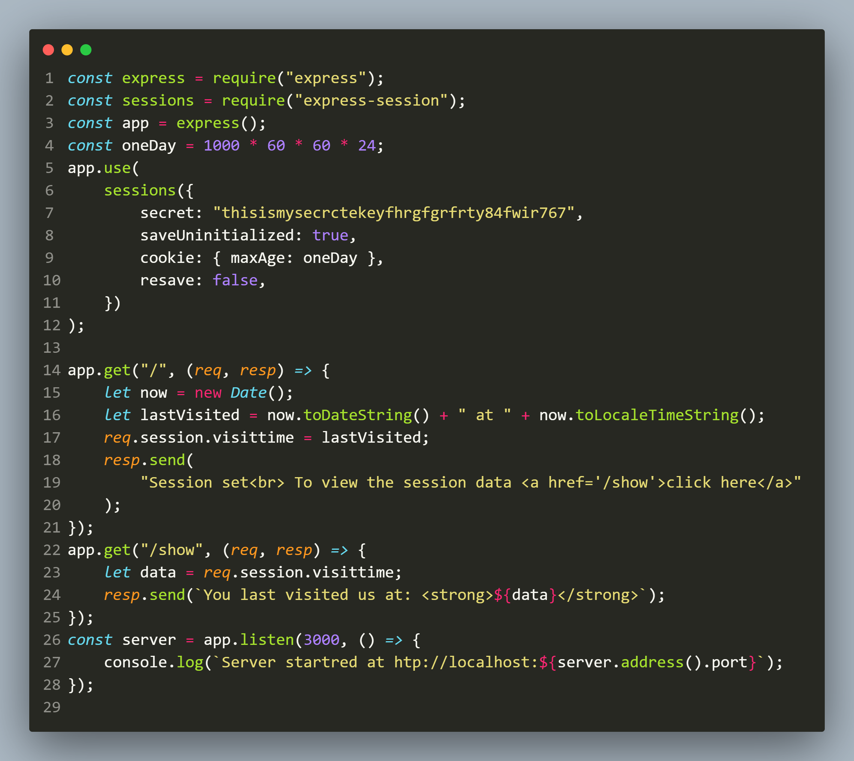
Solution

Slide 23
Exercise 90
Create an Express application which behaves as follows:
The user will access it as http://localhost:3000?username=<some_name>
On the first visit of the user the app should display the message “Hi <username> This is your visit no 1”.
On every other visit the message should change to “Welcome back <username> This is your visit number <count>”

Slide 24
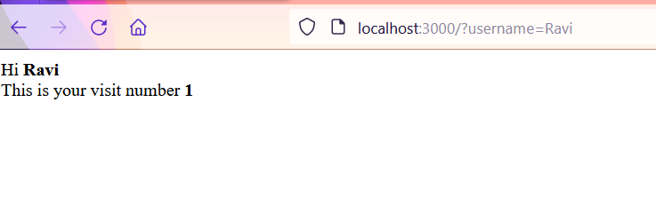
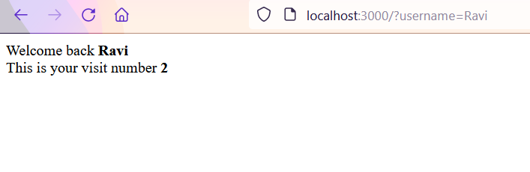
Desired output
http://localhost:3000?username=Ravi
On page refresh

Slide 25
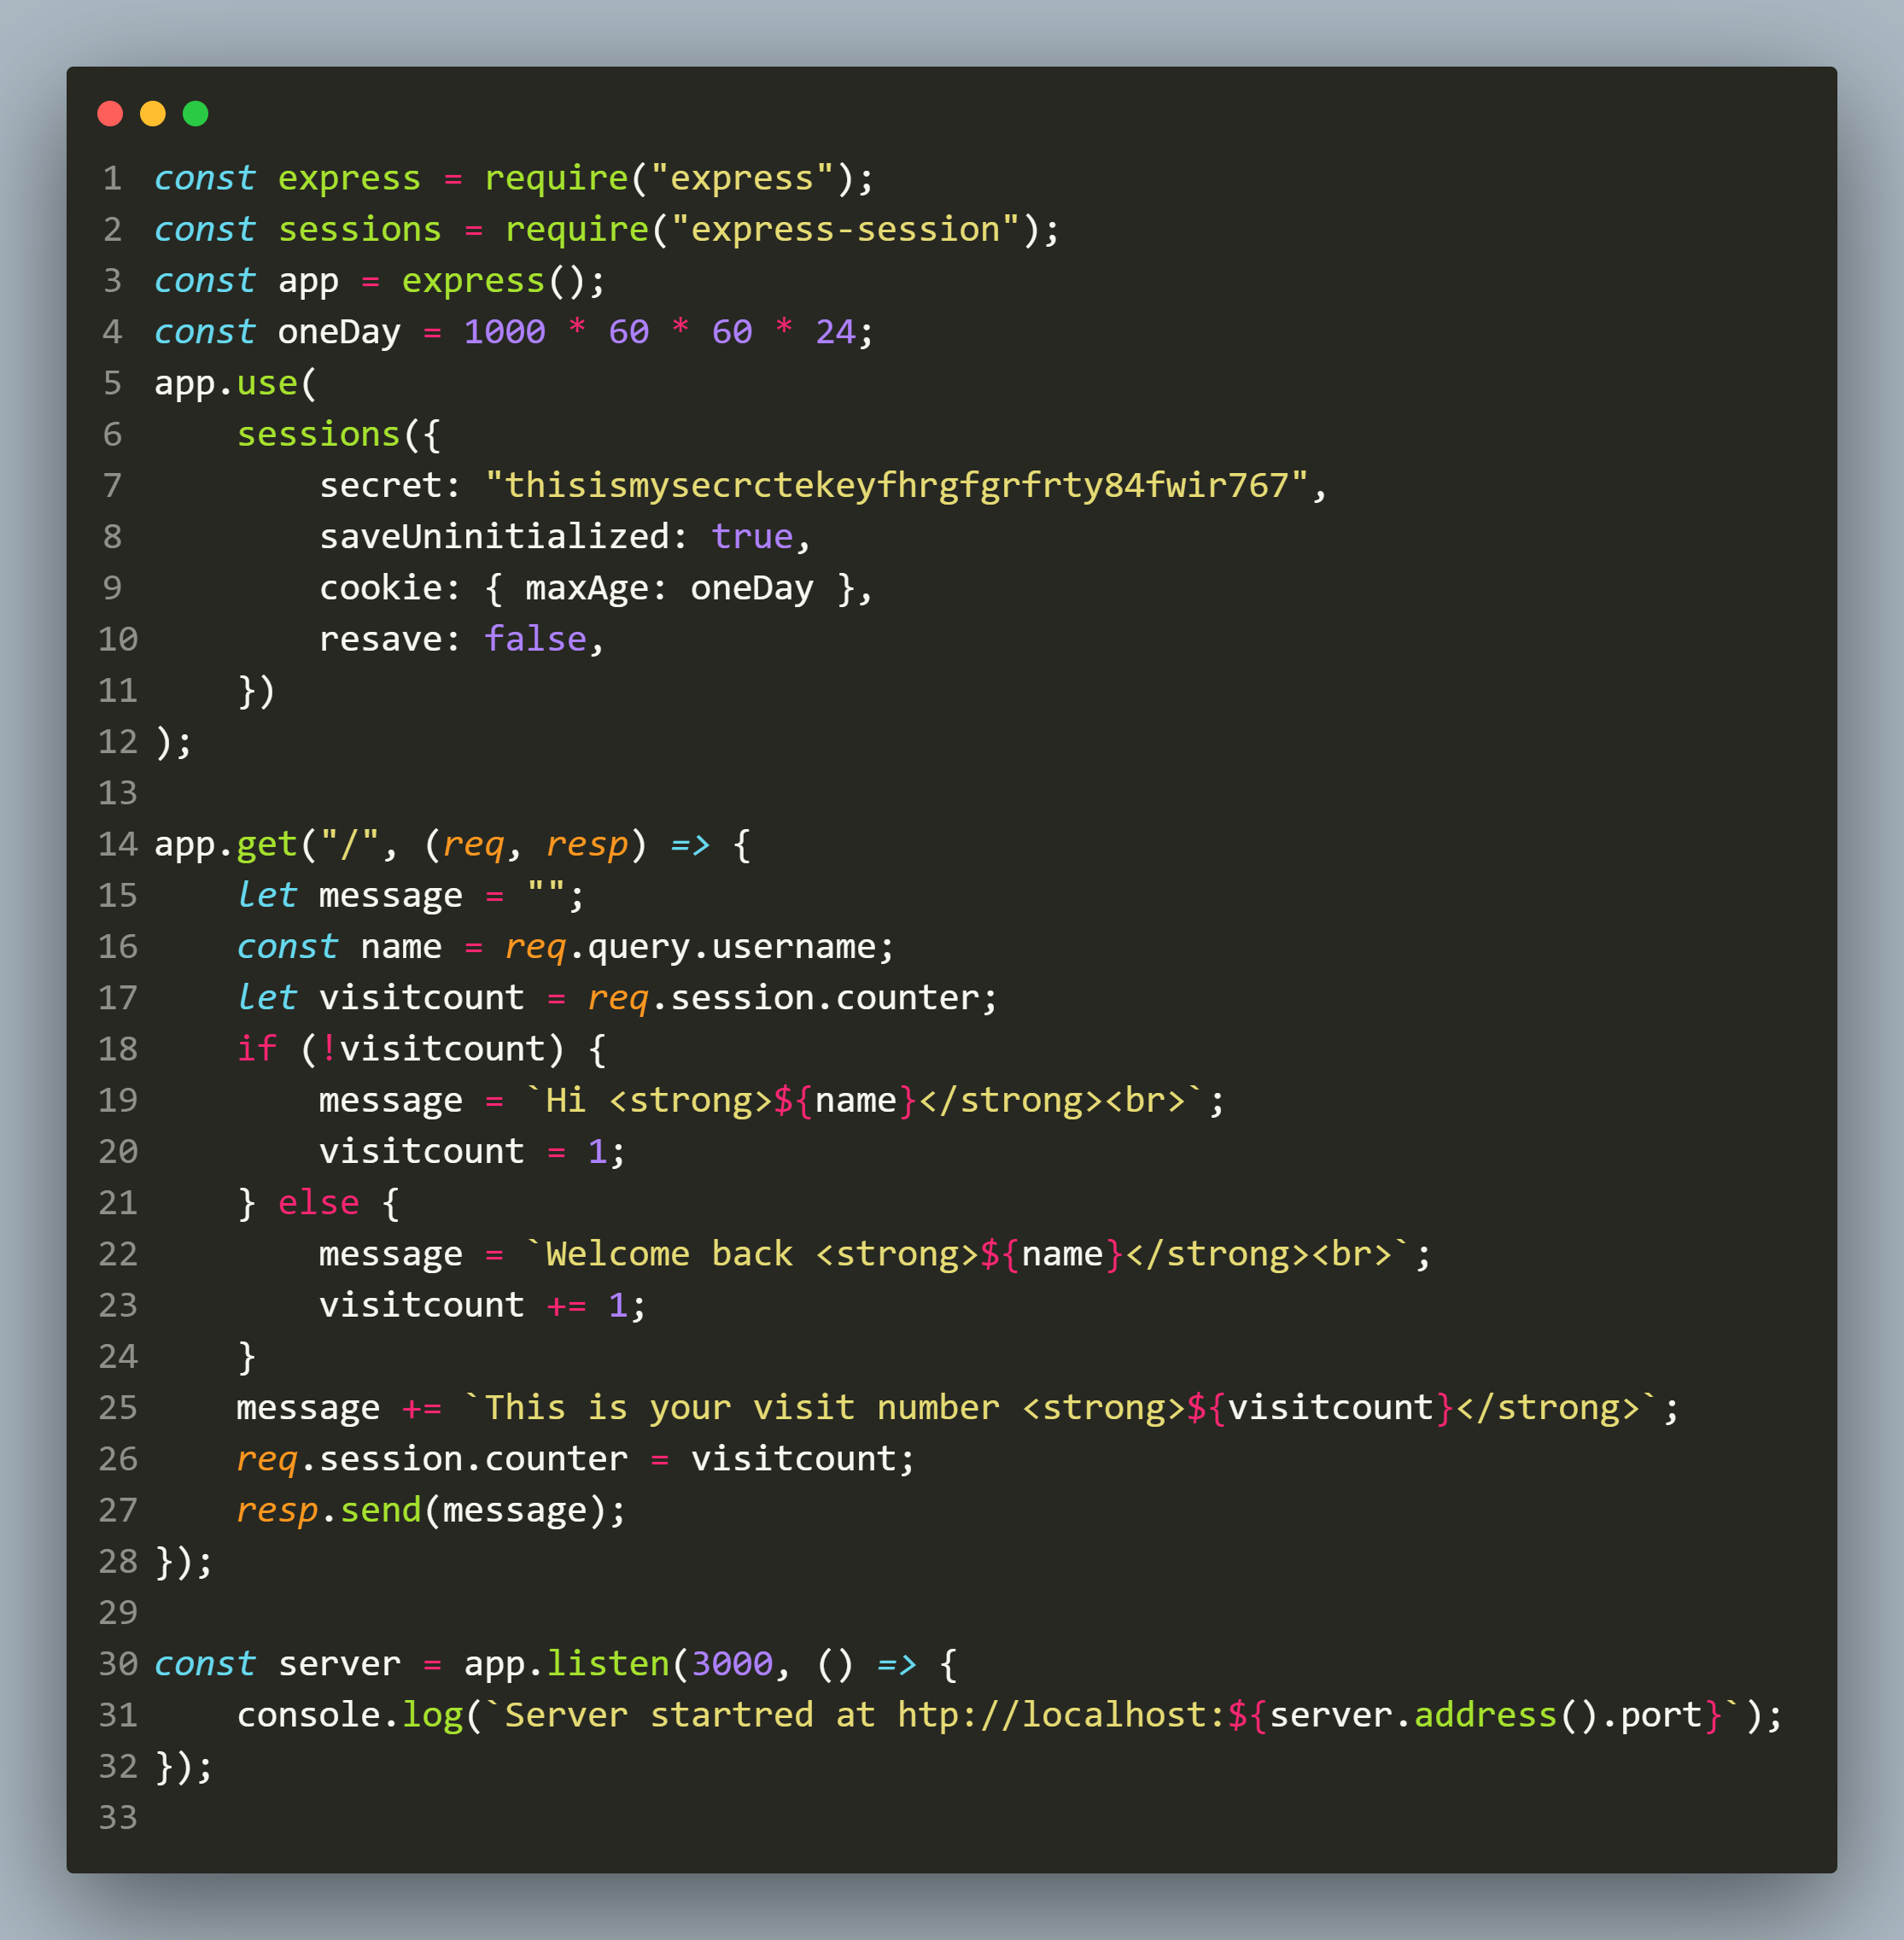
Solution

Slide 26
Removing data from a session
Since request.session is an object and the data we set in it becomes its property or key , so we can use the delete operator of JS to remove any key from a session.
Syntax:
delete req.session.<key>;
Example:
delete req.session.username;

Slide 27
Exercise 91
Modify the previous application so that it now provides a link to the user to clear the visit counts .
As soon as the user clicks it the counter should be removed.

Slide 28
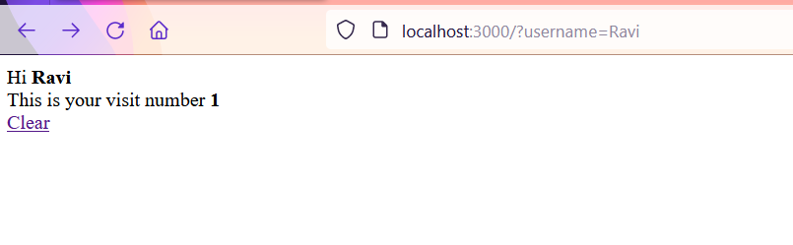
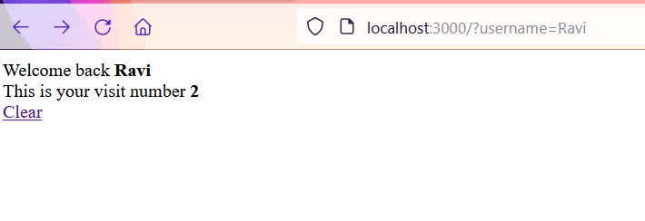
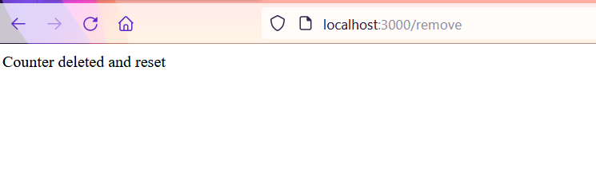
Desired output
http://localhost:3000?username=Ravi
On page refresh
On clicking Clear

Slide 29
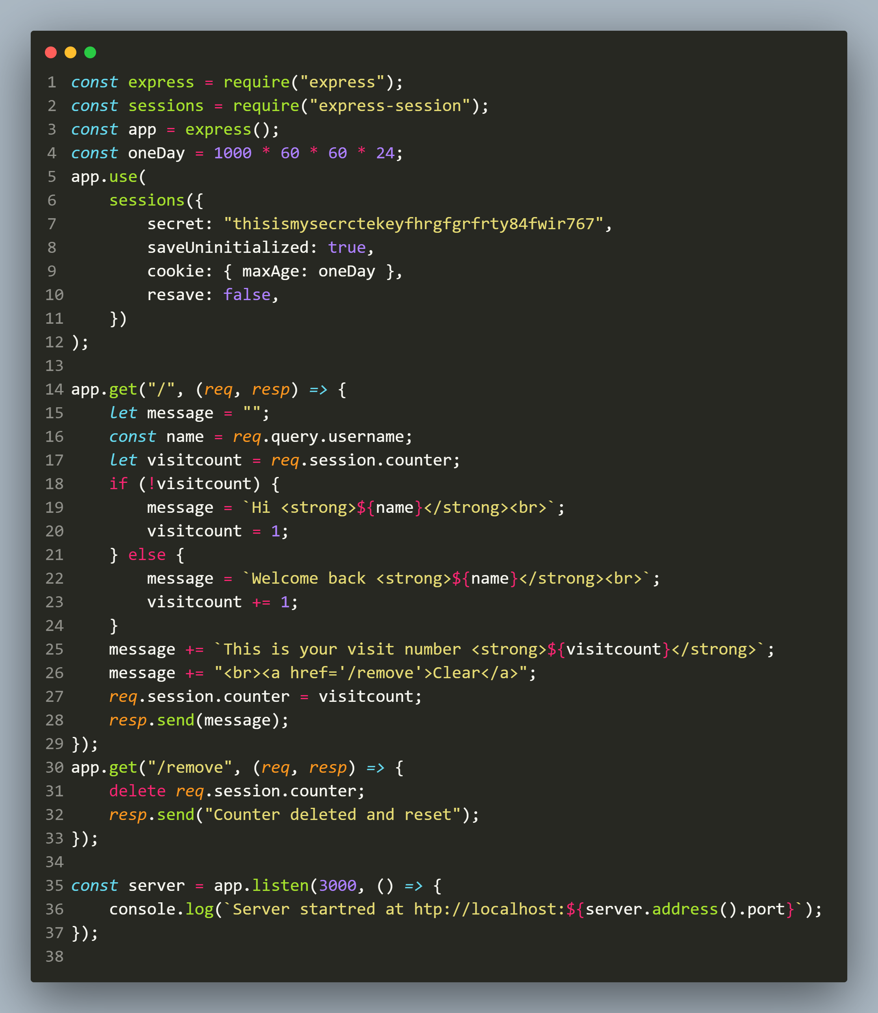
Solution

Slide 30
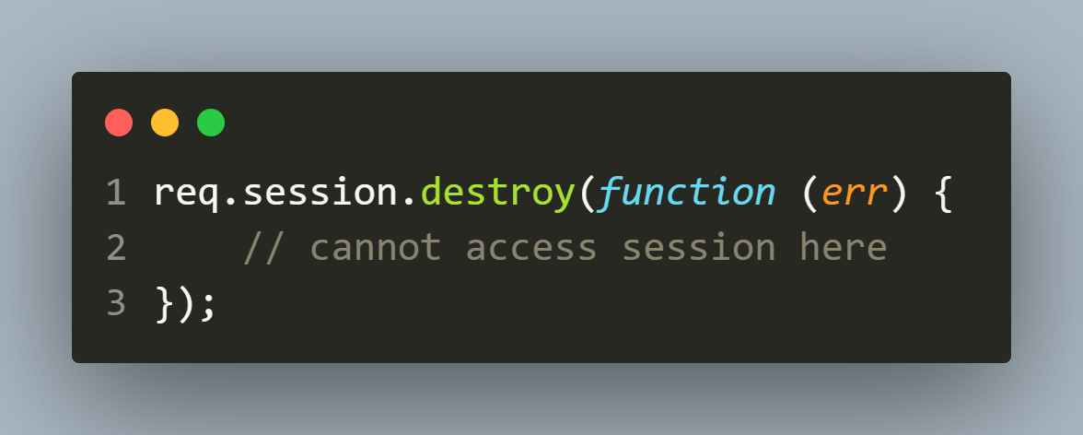
Destroying a session
To destroy a session we can simply call the method destroy() of req.session object.
Syntax:

Slide 31
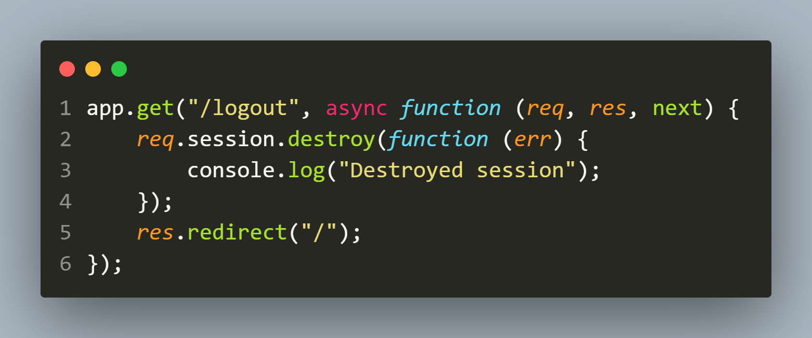
Logout example

Slide 32
Exercise 92
Rewrite the login/authentication example we discussed in cookie chapter but this time use session.

